Slide 1
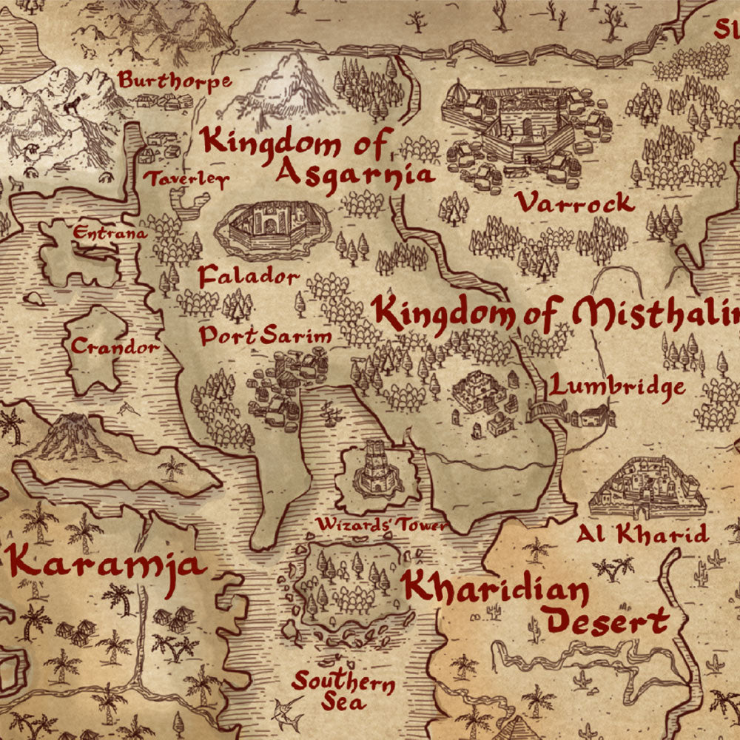
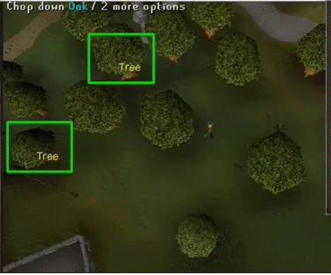
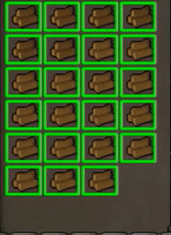
Runescape Woodcutting Script David Ballantyne Ian Ballantyne WHAT IS THE PROGRAM?
This program functions as an automated woodcutting bot to automatically do woodcutting in the game of RuneScape. It automatically cuts trees and alerts you when it is ready to bank. It performs this task my using your mouse and keyboard to position and move itself into a spot to complete the desired task.

